Slide 1
MS EXP-2
Case-Study on
Real-time data-driven discrete-event simulation for garment production lines
Presented by:
Riya Thapar - 16010421118
Aarya Tiwari - 16010421119

Slide 2
Table of Contents
Introduction
Objective of the Paper
Resources Used
Simulation Steps
Results
Inferences
References

Slide 3
Introduction
The challenge in garment production lies in the traditional method of designing production lines, where experts use a small number of samples (3–5) to estimate task times for each workstation.
This limited sampling leads to inaccurate estimations, hindering the achievement of a consistent production rate and causing issues like bottlenecks and starvation points.
With rising global competition, the garment industry is adopting Industry 4.0 technologies to address these challenges and improve overall efficiency.

Slide 4
Objective of the Paper
The objective of this paper is to propose a discrete-event simulation model-based approach to assess real-time garment production line productivity using real-time production line data.
Key Focus: Enhancing productivity, reducing human error and identifying potential bottle-necks and starvation points in the garment industry.
Enhance Accuracy: Utilize real-time data to improve the accuracy of productivity assessments.
Case Study Implementation: Apply the new approach to a real garment production line and analyze the results.
Outcome Focus: Aim to provide a more efficient and error-resistant methodology for assessing productivity in garment manufacturing.

Slide 5
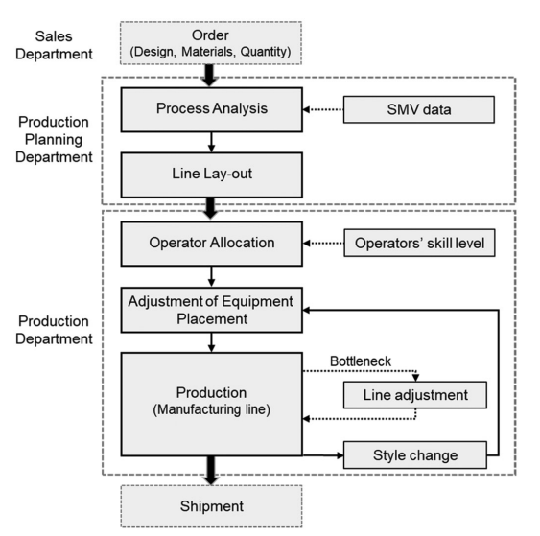
Resources Used
ICT-Based Power Monitoring System (PMS): Employed in sewing machines to collect real-time power data.
Simulation-Based Productivity Assessment: Utilizes PMS task time data for precise analysis.
Pattern Analysis Algorithm: Extracts worker task times from power data for integration into the simulation model.

Slide 6
Simulation Steps
Data Collection
The first step involves collecting data from the garment production line using an ICT-based PMS. The PMS captures real-time data on the task times of individual workers, the movement of materials, and the utilization rate of workstations .
ICT-Based Power Monitoring System (PMS): Each sewing machines is equipped with a PMS featuring a current sensor and a Wi-Fi communication module to capture real-time power consumption data.
Wireless Data Transmission: The collected data is transmitted to a cloud server through a wireless network for further processing and analysis.

Slide 7
Simulation Steps
Data Processing and Extraction
Data processing on the server extracts real-time task time data for each worker. It uses an algorithm to identify work patterns from power consumption profiles and calculates task times using statistical approximations and similarity measurements.
Piecewise Aggregate Approximation (PAA) and Symbolic Aggregate Approximation (SAX):
Data is segmented using PAA, simplifying each segment to its average value.
Each segment value is then represented by a character using SAX.
Similarity Measurement with Dynamic Time Warping (DTW):
Task recognition involves measuring similarity between the work pattern reference profile and the SAX representation of real-time data.
DTW is applied for similarity measurement.

Slide 8
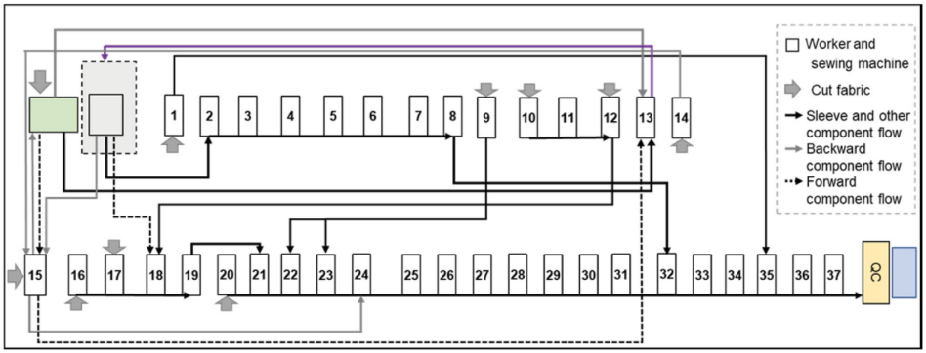
Simulation Steps
Simulation Model Development
The collected data is then used to develop a discrete-event simulation (DES) model of the garment production line. This model is designed to reflect the complex nature of the production line and incorporates real-time data to accurately represent the dynamics of the production process.
Process Analysis
Flow, worker roles, component movement
Component Identification
Garment type and specific components
Software
AnyLogic Version 8 for modeling
Model Construction
Fabric flow, sewing tasks, module movement
Work Time Integration
Real-time task data from PMS

Slide 9
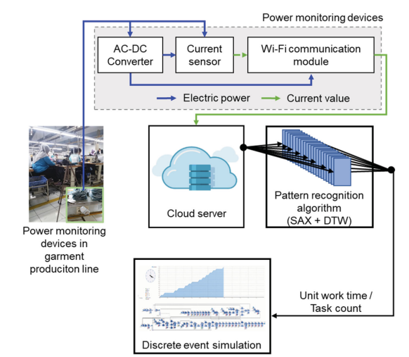
Simulation Steps
Validation
The simulation results are then validated against actual production results to ensure the accuracy of the simulation model. The simulation results are compared with results obtained from the conventional approach for the same garment production line .

Slide 10
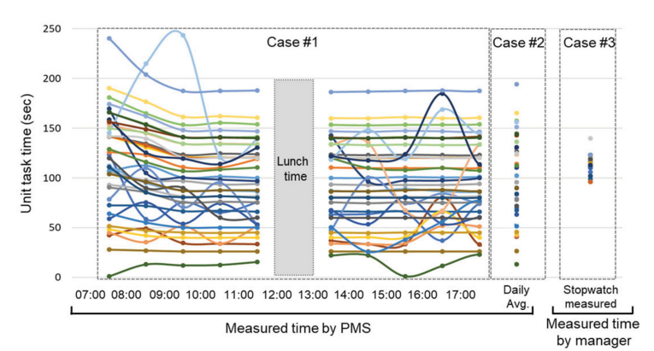
Results
Cases Considered:
Case #1: Apply the time measured using the PMS as a time unit,
Case #2: Apply the average time measured using the PMS, and
Case #3: Apply the time measured using a stopwatch
PMS-based measurements offer more accurate, hourly insights into individual worker performance compared to traditional stopwatch methods when the right monitoring infrastructure is in place.

Slide 11
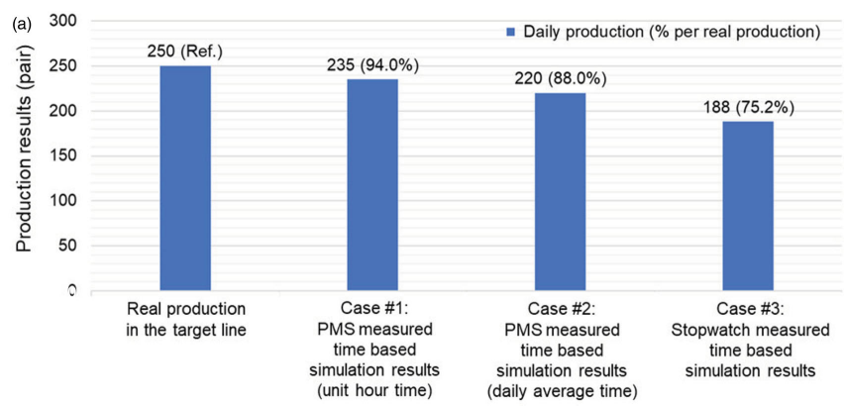
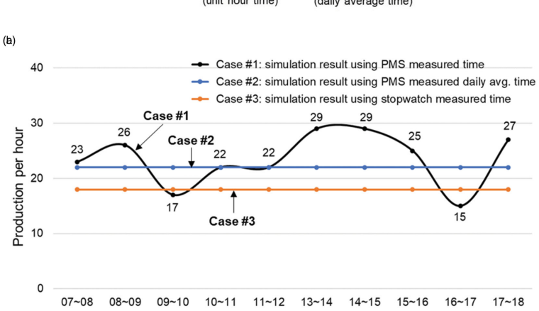
Results
The simulation model with ICT-based PMS provides more realistic production results compared to point data for unit task time. This enables precise hour-by-hour production predictions, aiding in maintaining stable production rates.

Slide 12
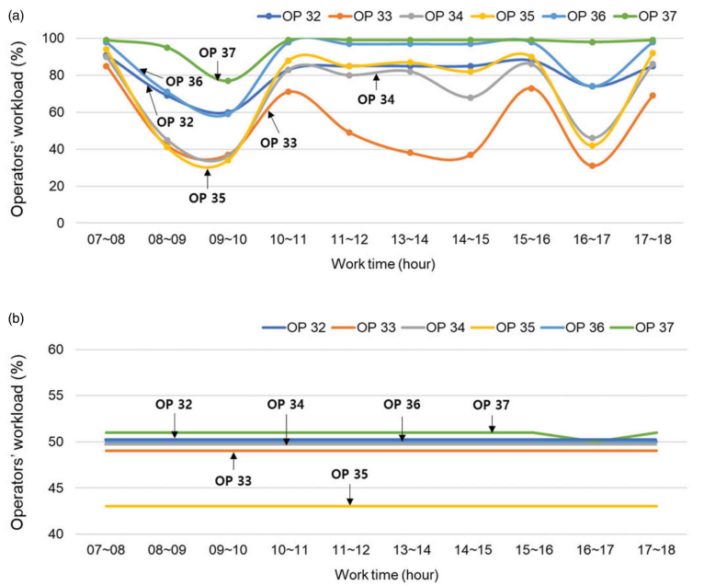
Results
Results reveals worker workloads during the shift, helping managers spot bottlenecks.
They can then adjust task allocation at busy workstations or assign more skilled workers to match task difficulty, improving efficiency.

Slide 13
Inferences
The paper showcases real-time data-driven discrete-event simulation and smart factory tech for boosting garment production industry productivity.
ICT-based Power Monitoring System (PMS) outperforms stopwatches, providing precise task time data from sewing machines.
Pattern analysis with PAA, SAX, and DTW extracts real-time task data for accurate worker and line performance assessment.
It was verified that the discrete-event simulation results of the garment production line using secured deterministic data were 94% similar to the actual production results.
Simulation results using real-time data are 18.8% more accurate than conventional methods.
The study provides insights for future research in line-balancing optimization and big data analysis.

Slide 14
References
https://www.researchgate.net/publication/346093550_Real-time_data-driven_discrete-event_simulation_for_garment_production_lines
https://www.researchgate.net/publication/221598030_A_Symbolic_Representation_of_Time_Series_with_Implications_for_Streaming_Algorithms
https://www.researchgate.net/publication/341032677_Remote_Sensing_of_Sewing_Work_Levels_Using_a_Power_Monitoring_System
https://pubs.aip.org/aip/acp/article-abstract/1643/1/460/882955/A-simulation-study-on-garment-manufacturing?redirectedFrom=PDF

Slide 15
Thank you

